Slide 1
Thanks for our advisor, Prof. Jeng. We appreciate your valuable recommendation about how to improve an overall quality of presentation and slides in final presentation. It is unforgettable experience about how to do a great data analysis for every group-members.
We fix almost all up in the modified version slides, such as some notation or figure.
But for (1) the training/test outcome visualization, we don’t update the new version because updating all figure may bring a big burden for group member. Therefore, we just update the one figure, as showed in the next page.
And (2), we also think the more comprehensive is needed indeed, such as comparation between house price between another type of stock. But we don’t update this in this slides. It need to search and collect the other source data and analysis it. Original source website {goodinfo.com} just provides REITs data.
Finally (3), we don’t try to add more lag_variable and make the ensemble model at this time, because (1) too long context may lead to overtime when presentation. (2) We analysis 6 different stock in this. if we add more lag_variable to do some comparison, we will need to train (6*2*5)=60 models. So, we don’t try to do that because it is quite expensive in time aspect, especially for high quality consideration for all model. But if in real-cases, such comprehensive experiment is needed.
1

Slide 2
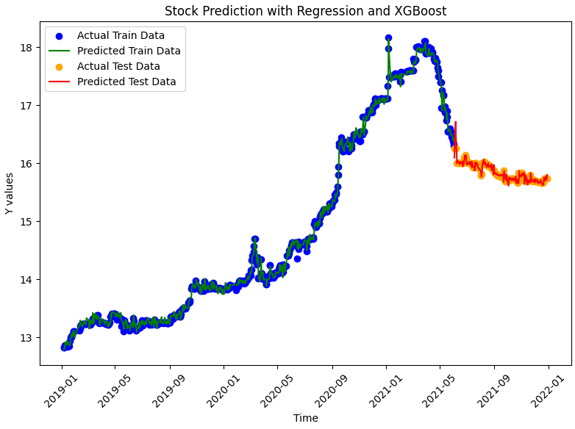

Slide 3

Predicting Stock Prices of Real Estate Investment Trusts Using Real Estate Information
112 Fall – Data Science, advised by Prof: Shuen-Lin Jeng
*Ming-Hsuan Wu, Wen-Hai Tseng, Jen-Lung Hsu, Chia-Ming Lee
Institute of Data Science, National Cheng Kung University
Jan 3, 2024
Presenter:
Chia-Ming Lee
* Team Lead
Notes:
大家好 我們是第一組 我們報告的主題是 使用房地產的實價登陸資訊預測房地產投資信託的股票價格
我們的組員分別是 吳明軒 曾文海 徐仁隆 李家銘

Slide 4

Outline
01
Introduction and Motivation
02
EDA and
Feature Engineering
03
Modeling Pipeline
04
Experiment Results
05
Conclusion and Discussion
Notes:
這個是我們的outline，我們大概會再第一章介紹的地方說明一下我們的動機以及做一些簡單的文獻回顧
然後接著在第二章介紹一下介紹一下dataset以及前處理的部分 然後在第三章介紹一下建模的流程
最後則是說明實驗結果

Slide 5
01
Introduction and Motivation
02
EDA and
Feature Engineering
03
Modeling Pipeline
04
Experiment Results
05
Conclusion and Discussion
Notes:
那我們先快速地過一下第一章介紹的部分

Slide 6

01
Introduction
(1/3)
Target and Goal
Our goal is to use real estate transaction data to predict the stock prices of Real Estate Investment Trusts (REITs). We plan to forecast signals related to stock price fluctuations using data science technology.
6
Notes:
我們的目標是利用房地產交易數據，或者是說實價登陸資訊來預測房地產投資信託基金（REIT）的股票價格。 我們這次報告會使用幾個機器學習的經典模型，來查看他們之間的交互關係，做一些簡單的分析

Slide 7
01
Introduction
(2/3)
Motivation (Our Novelty) and Related Works
To our best knowledge, there is no paper introducing a comprehensive study between stock and housing price in all Taiwan city. So, we want to combine some research’s advantage to better understand/predict the correlation of Stock and Housing Price in Taiwan.
Wang et al. [1] considered the housing policy have a huge impact on the stock price. The object of its discussion is the relationship between housing prices (mainly focus on tax/policy) and architectural industry stock prices in Taiwan.
Feng et al. [2] explored whether there is a relationship between housing prices and stock prices between China and four Asian countries (Taiwan, Hong Kong, South Korea, and Singapore). It conducted nonlinear time-series models and many experiments in the paper.
Refai et al. [3] provide a comprehensive analysis of the dynamic linkages between real estate and stock markets in Qatar and help to uncover the short and long-term dynamics of these markets. ​
Lin et al. [4] aims to harness the power of Machine learning techniques (SVM, LSTM, Linear Regression, MLP) to accurately forecast housing prices across various neighborhoods within Taipei City.
[1] 政府打炒房的租稅與行政措施對於臺灣營建類股股價的影響-以事件研究法分析, 王紅晴, 2022.
[2] Nonlinear Short-Run Adjustments between House and Stock Prices in Emerging Asian Regions​, Feng et al., 2018.
[3] The dynamics of the relationship between real estate and stock markets in an energy-based economy: The case of Qatar, Refai et al, 2021.
[4] Research and Analysis of the House Price Prediction using Artificial Intelligence Models, Lin et al., 2019
7
Notes:
據我們所知，過去是有一些文獻做了相關的研究和分析，但他們概括的點或是說著重的點都不太一樣，
還沒有研究是針對全台灣城市的房價和股市進行全面的探討和分析(也有可能是不好做，影響的因素太多)。
因此，我們希望結合我們查閱到的幾篇論文的優勢來更好地理解/預測台灣股票和房價的相關性。
具體來說呢，我們查閱到的第一篇論文是著重在台灣政府的租稅政策和營建類股價的影響
而第二篇論文則是中國和其他亞洲國家之間房市和股市之間互相影響的研究
第三篇則是探討卡達地區的房市和股市之間的長短期影響
而最後一篇則是利用機器學習的方式來去觀察台北市區的房價的變化
那這個大概就是文獻探討的部分
那我們覺得這個題目不好做的原因在於高品質的資料並不好取得，或者是不同區域之間的資料格式或特性可能不同，造成整合上不太容易

Slide 8
01
Introduction
(3/3)
Brief Dataset description
We utilize Real Estate Transaction Data extracted from {Tej.api}. This dataset records the transaction information(all city in TW) from 2017/12/01~2021/12/31.
We ​employ Real Transaction Data (Real Price Registration Information) from {goodinfo.com}. It contains 6 different type of stock in Taiwan.(土銀富邦R1、土銀國泰、土銀富邦R2、兆豐國泰、王道圓滿、京城樂富) The time range is from 2019/01/01 to 2021/12/29.
Real Estate Transaction Dataset (房市)
Feature
Engineering
Tej.api
Model for stock price prediction
7.xxx,
8.xxx,
12.xxx,
…
Group_by or
Concatenated
data
Web
scrawler
Real Price
Registration
Dataset (股市)
Feature
Engineering
8
Notes:
那我們這次使用的資料集分別是從
透過{Tej.api} 提取的台灣各地房地產的實價登錄資料。 這個資料集涵蓋了全台各地的房地產實價登陸的資料，然後時間則是從2017的12月到2021的年底。
那至於房地產股市的部分
我們採用來自 {goodinfo.com} 的真實交易資料（真實價格註冊資訊）。 包含台灣6種不同類型的股票，時間範圍為2019/01/01至2021/12/29。

Slide 9
Outline
01
Introduction and Motivation
02
EDA and
Feature Engineering
03
Modeling Pipeline
04
Experiment Results
05
Conclusion and Discussion
Notes:
接著是第二章 eda及資料前處理的部分

Slide 10
01
Introduction and Motivation
02
EDA and
Feature Engineering
03
Modeling Pipeline
04
Experiment Results
05
Conclusion and Discussion

Slide 11
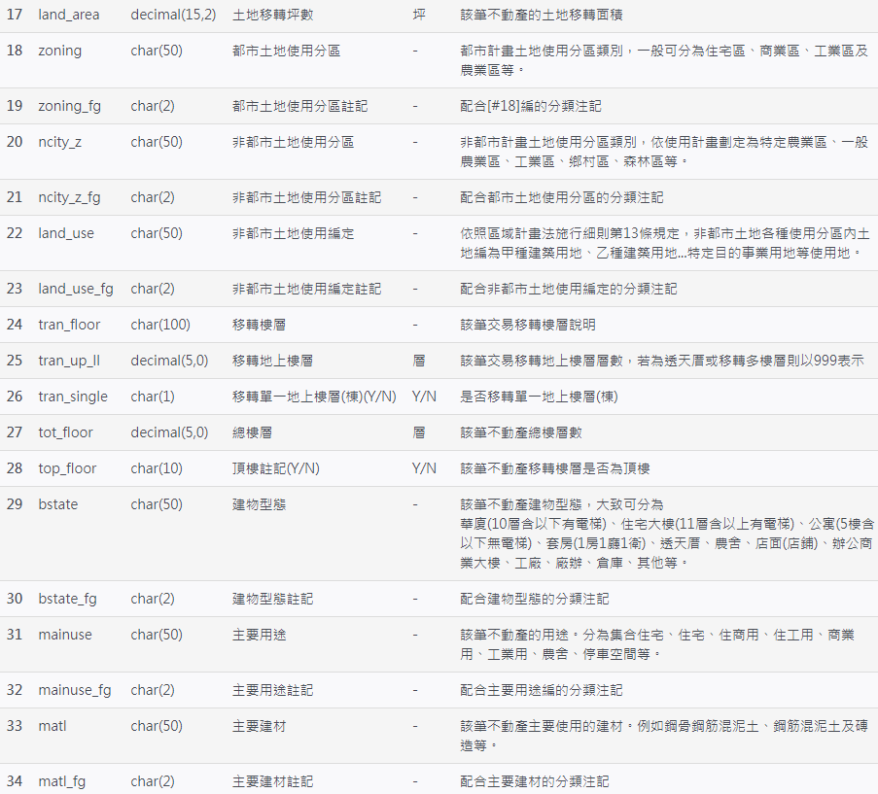
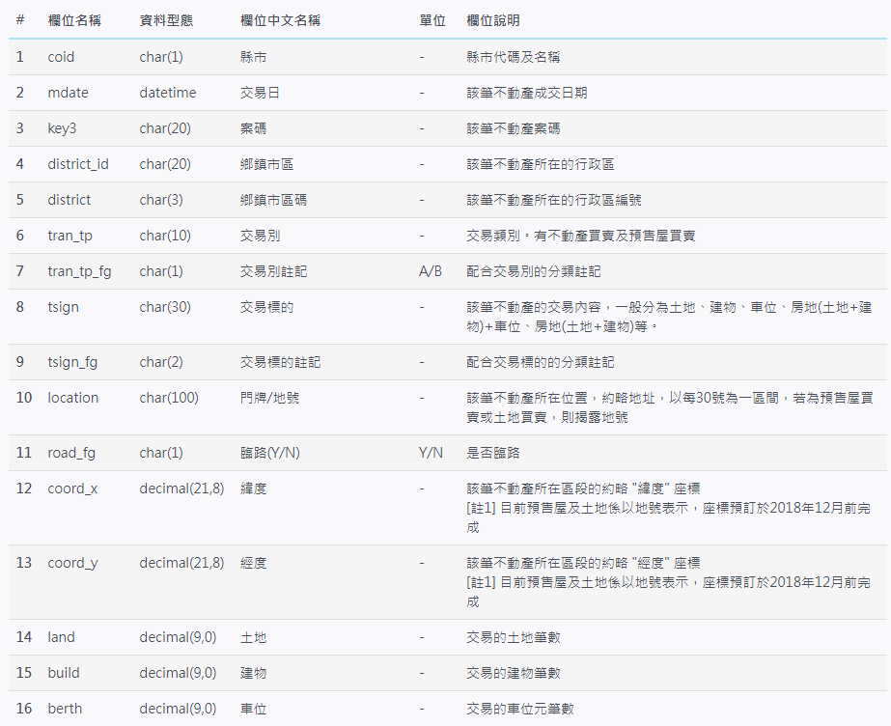
02
EDA and Feature Engineering
(1/10)
Same information, but different variable type
ID variable
Meta Data description (Housing)
11
Notes:
好，那這個是我們房地產實價登陸資料的一個資料說明，紅色的區域是跟id比較接近的feature，比方說房屋的地址或是序號或者是註解之類的
那藍色的地方則是他是兩兩一對的類別變數，這兩個意思基本上是一樣的，比方說一個是文字來記錄，另外一個則是用ABC或是123之類的來做這些文字的一個編號

Slide 12
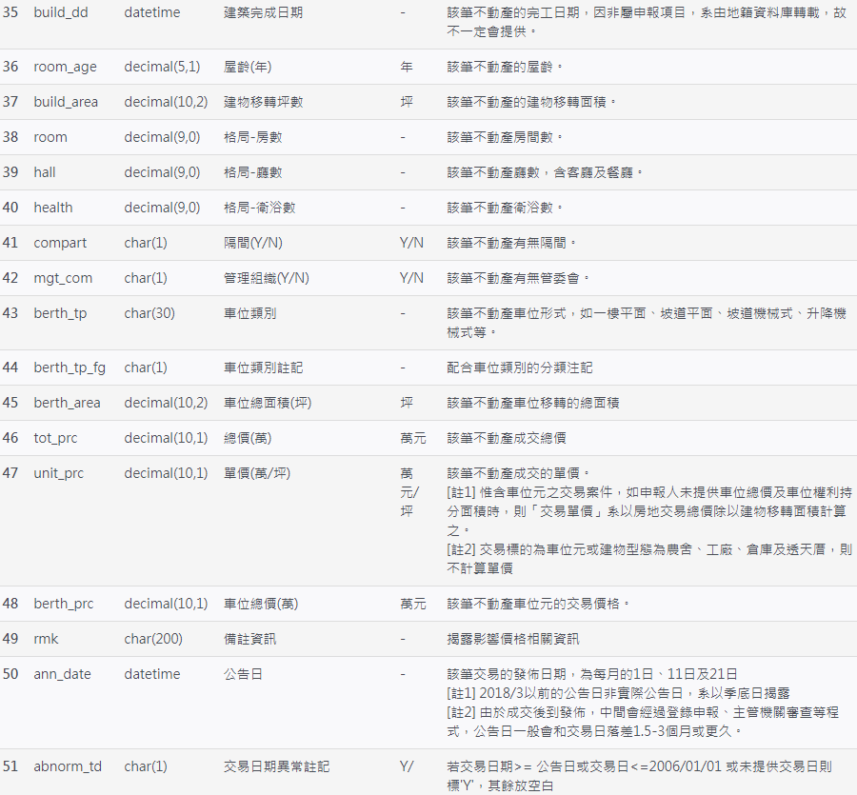
02
EDA and Feature Engineering
(2/10)
Meta Data description (Housing)
We totally collect 1,048,575 Real Estate Investment Trusts records(6 main capital), with 51 feature. (two features showed right are somehow uncaptured.)
Data shape: [1048575, 51]
char: 33, datetime:3, decimal: 15
Same information, but different variable type
ID variable
12
Notes:
那總共我們選擇了六個直轄市的資料來做，總共有一百萬筆左右，feature的總數有51個
那這51個feature裡面 其中有33個是被記錄成字串 這個有可能是一個布林變數 或者是類別變數
然後其他的話 有3個是日期變數 15個是數值變數
具體時間的話則是2017的年底到2021的年底

Slide 13
02
EDA and Feature Engineering
(3/10)
Meta Data description (Real Price Registration Information)
# | 欄位名稱 | 資料型態 | 欄位中文名稱 | 單位 | 欄位額外說明
1 | ID | str | 股票代號 |  | 01001T-->土銀富邦R1 01002T-->土銀國泰 01004T-->土銀富邦R2 01007T-->兆豐國泰 01009T-->王道圓滿 01010T-->京城樂富
2 | Date | datetime | 日期 |  | From 2019-01-01 16:00 to 2021-12-29 16:00:00
3 | Open | float | 開盤價 | 點
4 | High | float | 最高價 | 點
5 | Low | float | 最低價 | 點
6 | Close | float | 收盤價 | 點
7 | Change | float | 變化量 | 點 | (收盤價-開盤價)
8 | Change_rate | float | 變化率 | % | ((收盤價-開盤價)/開盤價)
9 | Amount | int | 成交額 | 元 | Target Variable
10 | Volume | int | 成交張數 | 張數
We totally collect 4,387 Real Price Registration Information records, with 10 feature. Without Missing Data
Data shape: [4387, 10]
13
Notes:
好 那接著是 股市資料的部分 這個部分相對就比較簡單 我們總共收集了六支不同股票的訊息
然後時間範圍的則是2019年初到~2021的年底 那總共有4387筆資料 然後有10個不同的feature

Slide 14
02
EDA and Feature Engineering
(4/10)
Modeling Assumption(Housing)
To easily and briefly capture the overall trending, we just analysis the major city’s REITs information. (around 80% data for 6 major city, and remains is for 16 non-major city, may contains imbalance-class issue.)
Prior Knowledge: room_age(屋齡), build_dd (建造日期) is important for house’ price.
Data Cleaning(Housing)
1. Missing Data Removal
3. Missing Data Imputation
a. Room_age and build_dd () Missing
a. Assign ‘unknown’ for category data
b. Serious Missing (80% data is missing)
b. Assign ‘99’ for numeric data
c. Rare level removal
d. Abnormal data removal
2. Modeling and Analysis Consideration
a. Non-category, non-time, non-numeric data will be removed (like rmk 備註資訊)
b. Outlier removal (or so called ‘specific purpose’, 特殊用地’, ’特殊用途’)
c. Too fine-grained level information (門牌, 案號), which may lead to overfitting.
14
Notes:
好 那剛剛是資料說明的部分 接下來我們說明這個資料前處理的部分
具體來說 我們是只選了六都的資料 大概跟前面說的一樣 總共100萬筆左右 其他都市的資料其實也是有 不過非常少

Slide 15
02
EDA and Feature Engineering
(5/10)
Feature Transformation (Real Estate Transaction Dataset)
All temporal feature will be transformed and split to following feature.
(年: 月: 日: 一年中的第幾週: 星期幾: 幾點)
(year: month: day: number of week: day of the week: hour)
Low rank: If two (or more) features have very similar semantic representation in high dimension space, so one of these should be removed.
(e.g. bstate (套房(1房1廳1衛)) == bstate_fg (4))
Data cleaning
Modeling Consideration
Feature Transformation
1-a. Remove [467980,] data
2-a. Remove [,1] data
Real Estate Transaction Dataset
3-a. Add [,12] feature, remove [,2] feature
1-b. Remove [,8] feature
1-c. Remove [30734,] data
2-b. Remove [35126,] data
1-d. Remove [24923,] data
2-c. Remove [,2] data
3-b. remove [,9] feature
[1048575, 51]
[524938, 43]
[489812, 40]
[489812, 41]
Overall Feature Engineering Flowchart for Housing data
15
Notes:
524938-55741

Slide 16
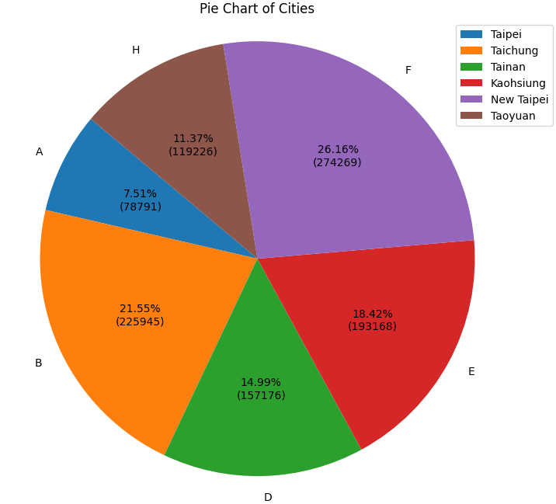
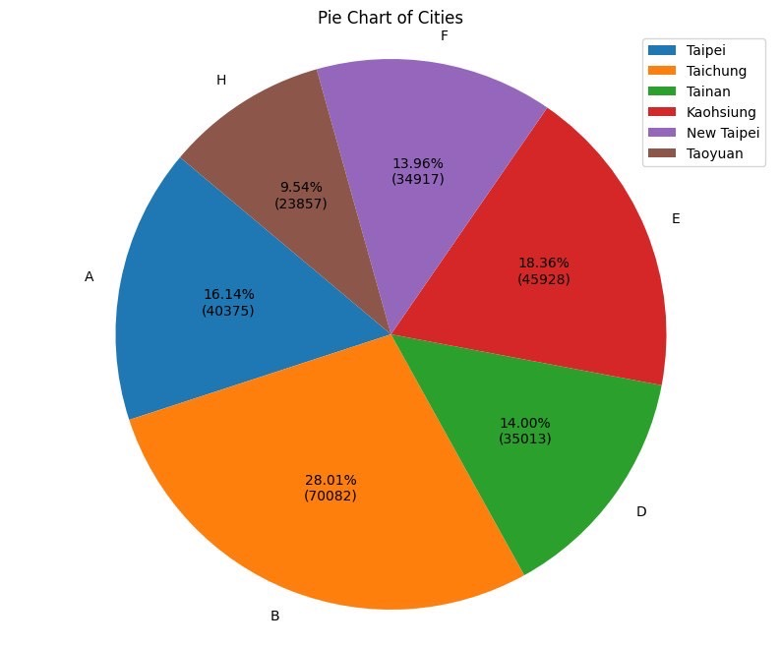
02
EDA and Feature Engineering
(6/10)
decrease
Taoyuan
Taipei
increase
Taichung
increase
Figure1: City distribution plot before data cleaning
Figure2: City distribution plot after data cleaning
16
Notes:
Rain13k

Slide 17
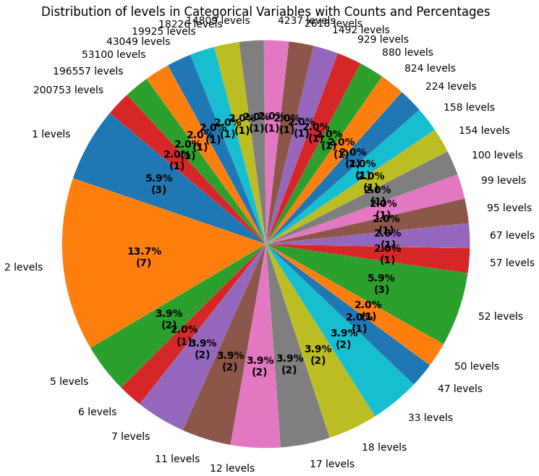
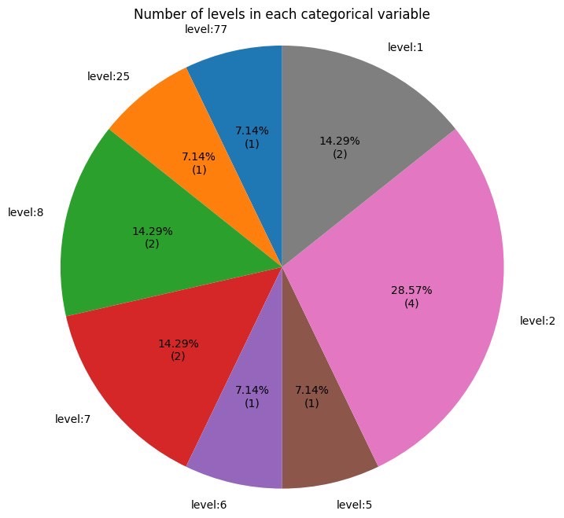
02
EDA and Feature Engineering
(7/10)
Noisy!!
Figure3: distribution of levels in category variables before data cleaning
Figure4: distribution of levels in category variables after data cleaning
17
Notes:
Rain13k

Slide 18
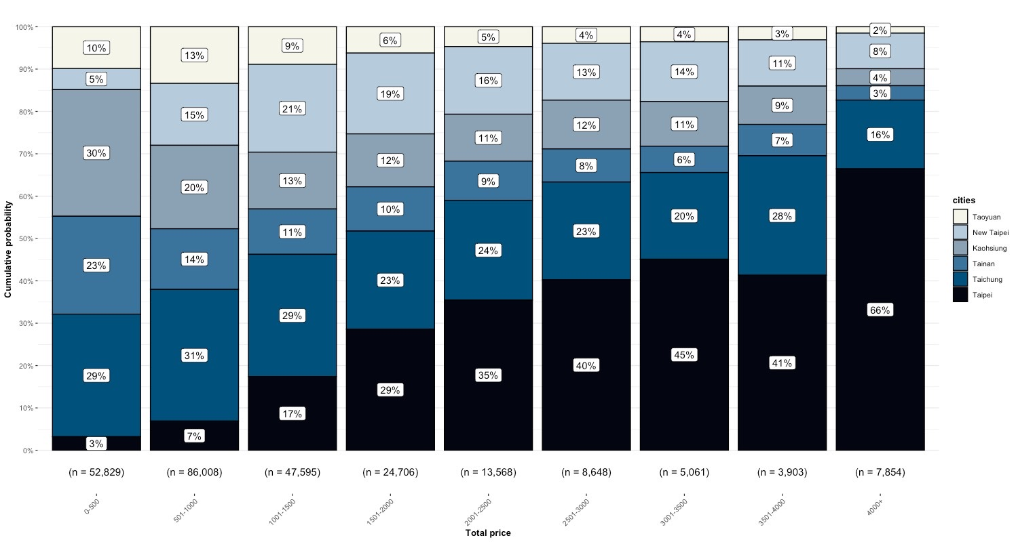
02
EDA and Feature Engineering
(8/10)
單位: 萬
Figure5: The distribution plot between different total_price groups and citys
18
Notes:
Rain13k

Slide 19
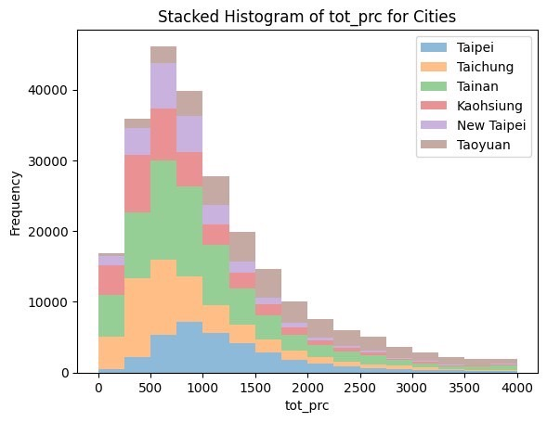
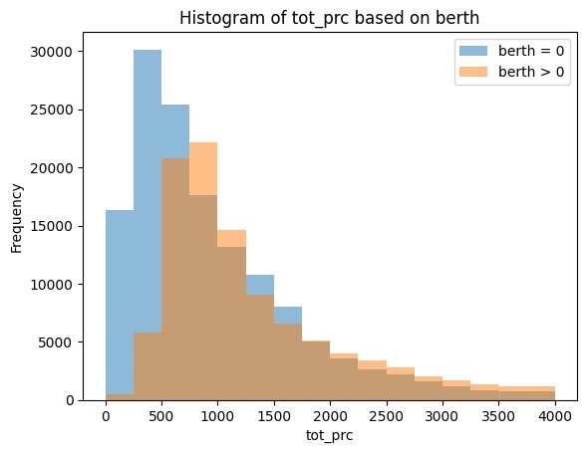
02
EDA and Feature Engineering
(9/10)
單位: 萬
單位: 萬
Figure6: The stacked histogram of total_price for different cities
Figure7: The histogram of total_price based on having berth or not
19
Notes:
Rain13k

Slide 20
728
02
EDA and Feature Engineering
(10/10)
Data Aggregation and Feature Engineering
Spatial Info Retrieval
Group by
{by:[coid, date]}
And aggregate by mean
For numeric variable
Split by stock ID and Delete NA
Model for stock price prediction
Cleaned
Real Estate Transaction Dataset
Select
date_year=2019,2020,2021
[728, 411]
[4697, 29]
Concatenate by [coid,date]
And remove
redundant feature
One-hot/Target Encoding and
Group by
{by:[coid, date]}
And aggregate by mode
For Category data
[489812, 41]
[250172, 41]
[27 numeric,
14 category]
[4697, 103]
[4697, 102]
Split by date
0.8 for training
0.2 for testing
XGBOOST
Linear Regression
Decision Tree
Random Forest
Support Vector Machine
Real Price
Registration
Dataset
A. Add last3day feature
B. Add ‘close’ price
[4387, 10]
[3167, 10]
[582, 411]
[146, 411]
7.xxx,
8.xxx,
12.xxx,
…
[4697,102+102*3+1]
[4697,411]
20
Notes:
Rain13k

Slide 21
Outline
01
Introduction and Motivation
02
EDA and
Feature Engineering
03
Modeling Pipeline
04
Experiment Results
05
Conclusion and Discussion

Slide 22
01
Introduction and Motivation
02
EDA and
Feature Engineering
03
Modeling Pipeline
04
Experiment Results
05
Conclusion and Discussion

Slide 23
03
Modeling Pipeline
(1/2)
Hyperparameter Searching
Preprocessed Data
Split Data by
Date time
Cross
Validation
Hyperparameter Searching
Train model
prediction
Final
Conclusion
Model
Explanability
Model​ | Hyperparameter​
​ | 01001T​ | 01002T​ | 01004T​ | 01007T​ | 01009T​ | 01010T​
DT​ | max_depth=5​ min_samples_leaf=4​ | max_depth=15​ min_samples_leaf=2​ min_samples_split=10​ | max_depth=10​ min_samples_split=5​ | max_depth=15​ min_samples_leaf=4​ | min_samples_leaf=4​ min_samples_split=5​ | max_depth=5​
RF​ | max_depth=5​ min_samples_leaf=2​ n_estimators=50​ | min_samples_leaf=2​ min_samples_split=5​ n_estimators=50​ | max_depth=5​ min_samples_split=10​ n_estimators=50​ | max_depth=5​ min_samples_leaf=2​ min_samples_split=10​ | max_depth=15​ min_samples_leaf=4​ n_estimators=50​ | max_depth=10​ n_estimators=50​
XGBoost​ | learning_rate=0.1​ max_depth=3​ n_estimators=300​ | learning_rate=0.1​ max_depth=7​ n_estimators=100​ | learning_rate=0.1​ max_depth=3​ n_estimators=300​ | learning_rate=0.1​ max_depth=7​ n_estimators=200​ | learning_rate=0.1​ max_depth=3​ n_estimators=200​ | learning_rate=0.1​ max_depth=7​ n_estimators=100​
SVM​ | C = 10​ | C = 10​ | C = 10​ | C = 10​ | C = 10​ | C = 10​
All Linear Regression model is with LASSO (alpha is fixed to 0.1)
23

Slide 24
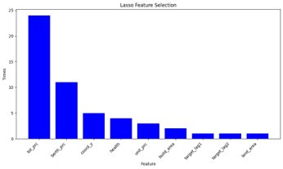
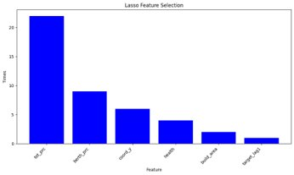
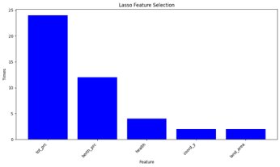
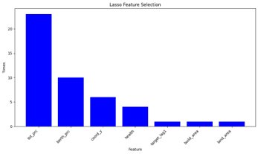
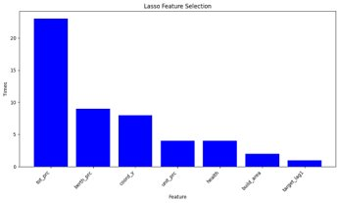
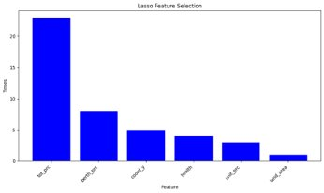
03
Modeling Pipeline
(2/2)
LASSO Feature Selection in All Linear regression model(alpha=0.1)
Preprocessed Data
LASSO
Feature Selection
Split Data by
Date time
Train model
prediction
01001T 土銀富邦R1 (52 features)
01004T 土銀國泰 (44 features)
01009T 土銀富邦R2 (44 features)
01002T 兆豐國泰 (46 features)
01007T 王道圓滿 (51 features)
01010T 京城樂富 (44 features)
24
Notes:
Rain13k

Slide 25
Outline
01
Introduction and Motivation
02
EDA and
Feature Engineering
03
Modeling Pipeline
04
Experiment Results
05
Conclusion and Discussion

Slide 26
01
Introduction and Motivation
02
EDA and
Feature Engineering
03
Modeling Pipeline
04
Experiment Results
05
Conclusion and Discussion

Slide 27
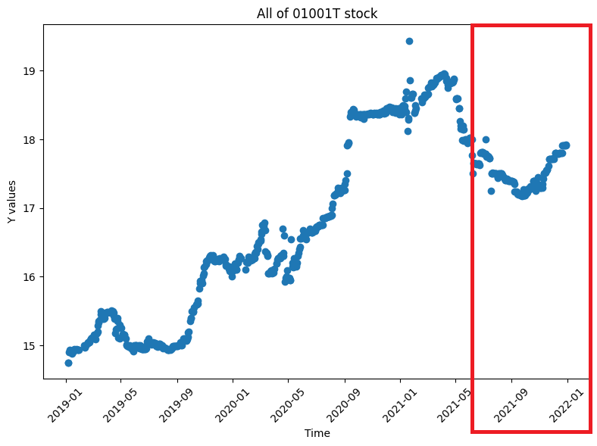
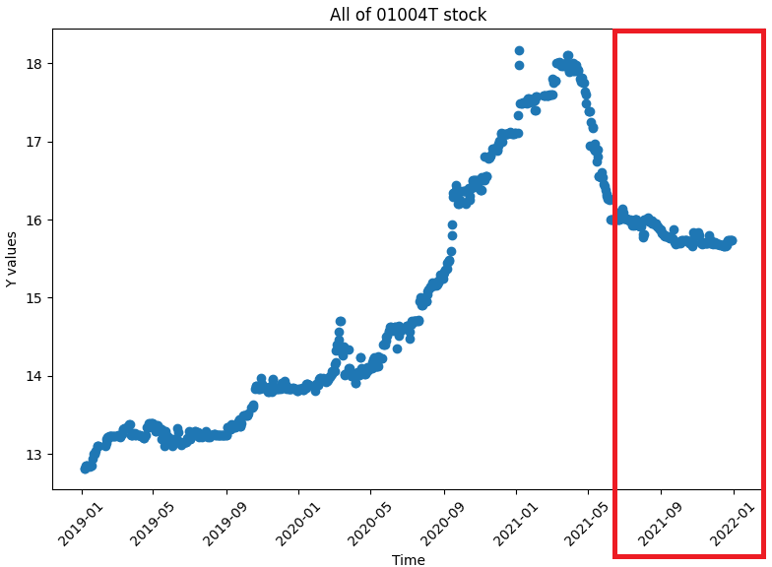
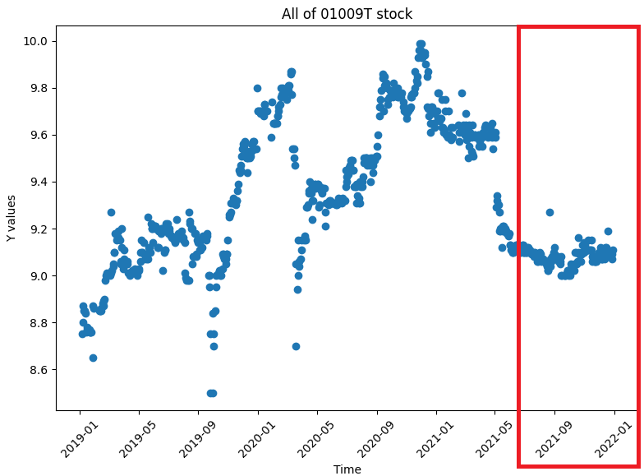
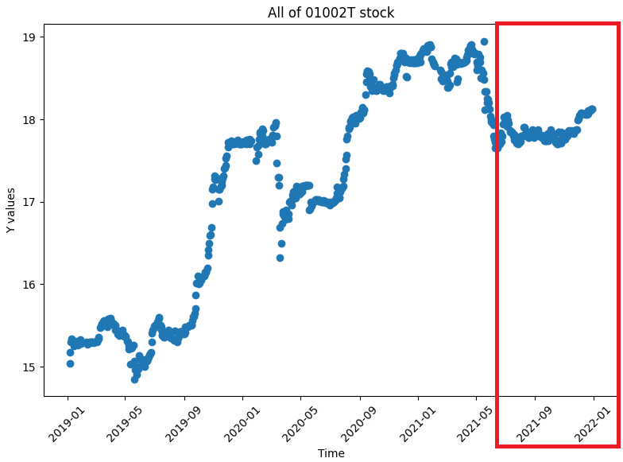
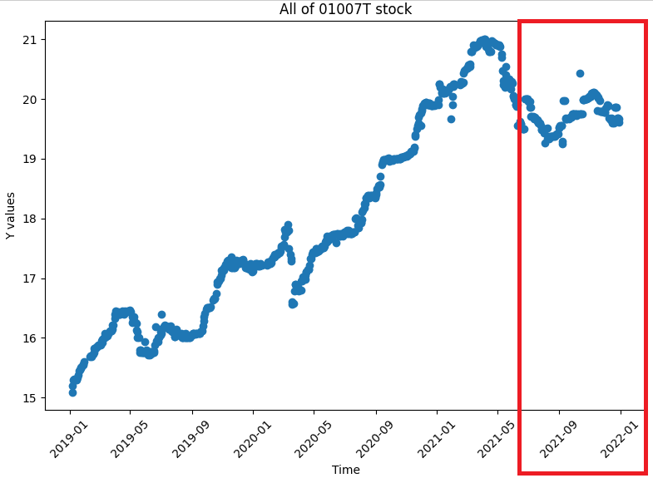
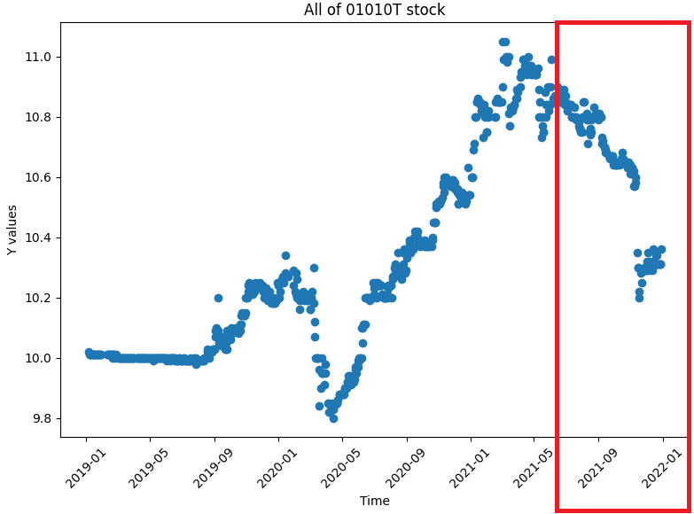
04
Experiment Results
(0/19)
Data Visualization (note: y-axis scale is different)
01001T 土銀富邦R1
01004T 土銀國泰
01009T 土銀富邦R2
01002T 兆豐國泰
01007T 王道圓滿
01010T 京城樂富
27
Notes:
Rain13k

Slide 28
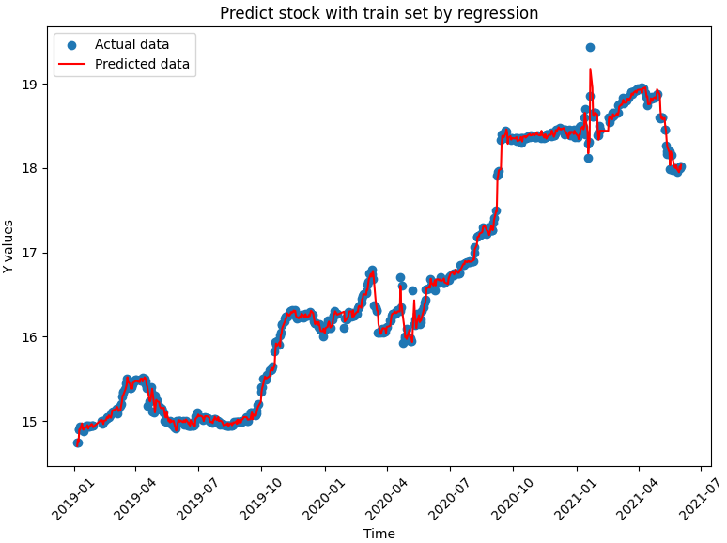
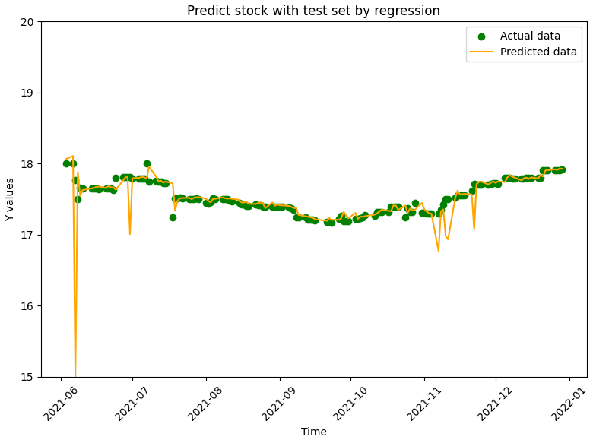
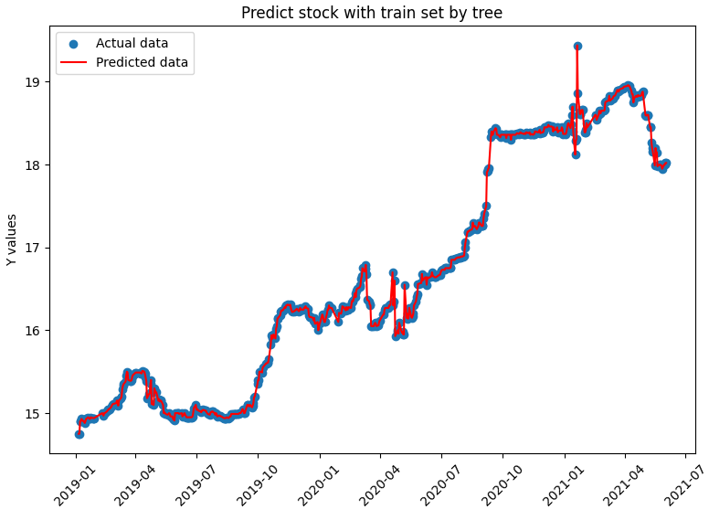
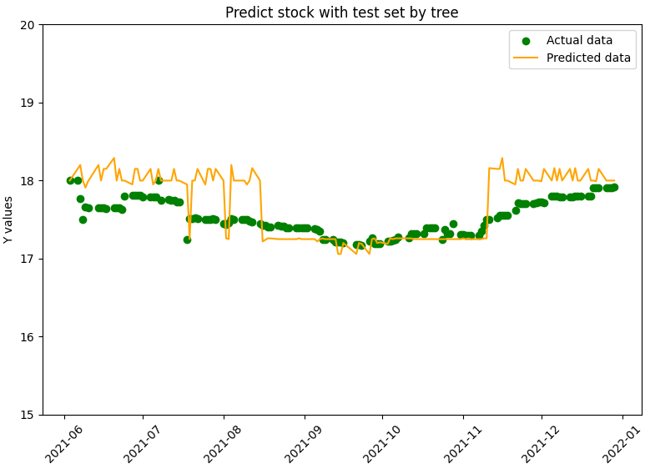
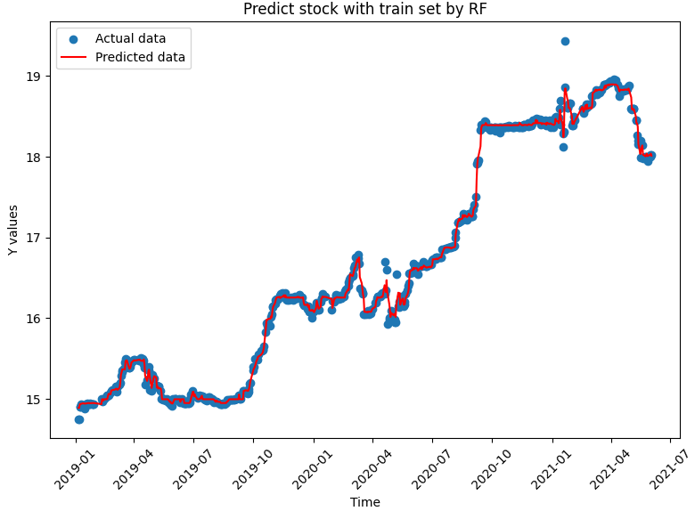
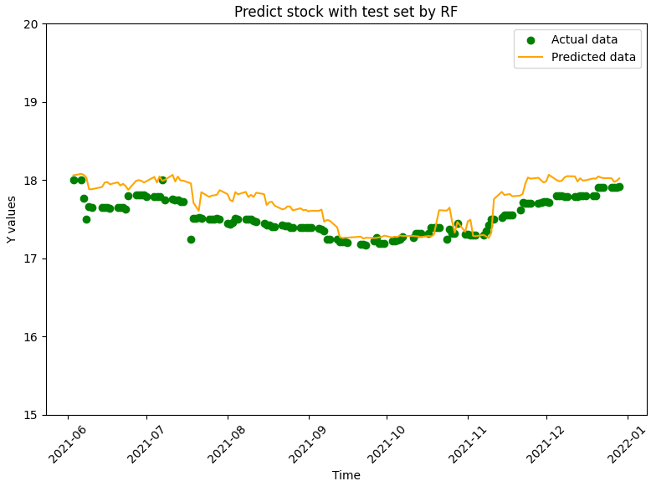
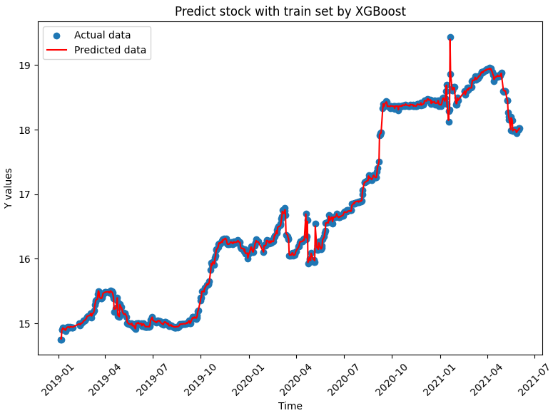
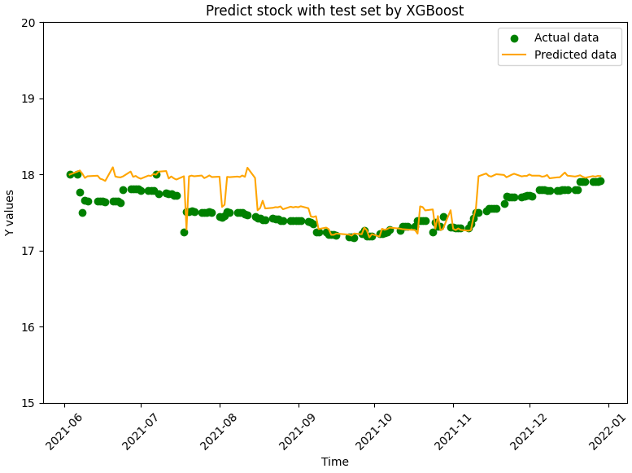
04
Experiment Results
(1/19)
Linear Regression
Testing | MAPE | MSE | RMSE
LR | 0.4511 | 0.0709 | 0.2664
TREE | 1.9913 | 0.1832 | 0.4280
RF | 1.1448 | 0.0535 | 0.2314
XGB | 1.1851 | 0.0684 | 0.2617
SVM | 0.4799 | 0.0741 | 0.2722
01001T 土銀富邦R1
Overall Performance Comparison
Decision Tree
Random Forest
XGBoost
Support Vector Machine
28

Slide 29
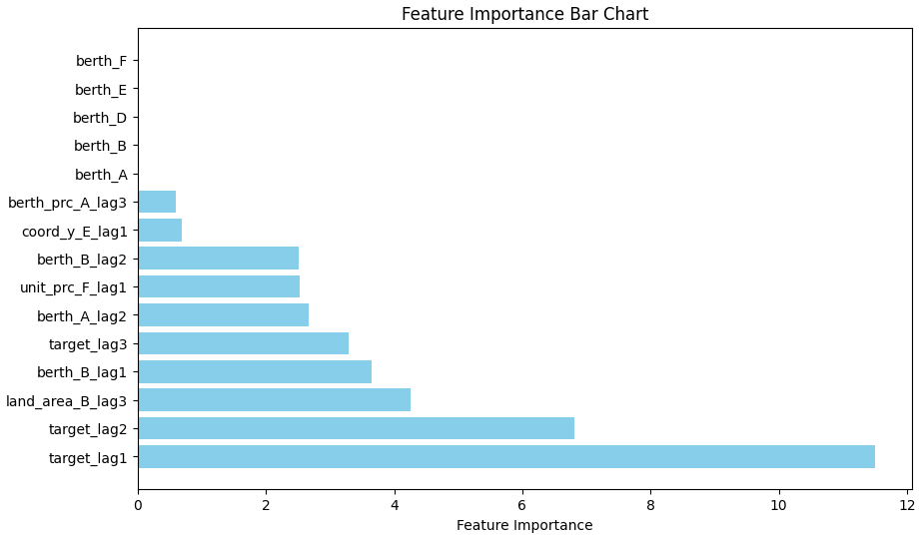
04
Experiment Results
(2/19)
01001T 土銀富邦R1
Model Explanablity
Feature Importance
INDEX | City | count
A | Taipei | 2
B | Taichung | 3
D | Tainan | 0
E | Kaohsiung | 1
F | New Taipei | 1
H | Taoyuan | 0
Berth_prc 車位價格
Coor_y 經緯度
Unit_prc 建案成交單價
berth 有無車位
land_area 土地移轉坪數
29

Slide 30
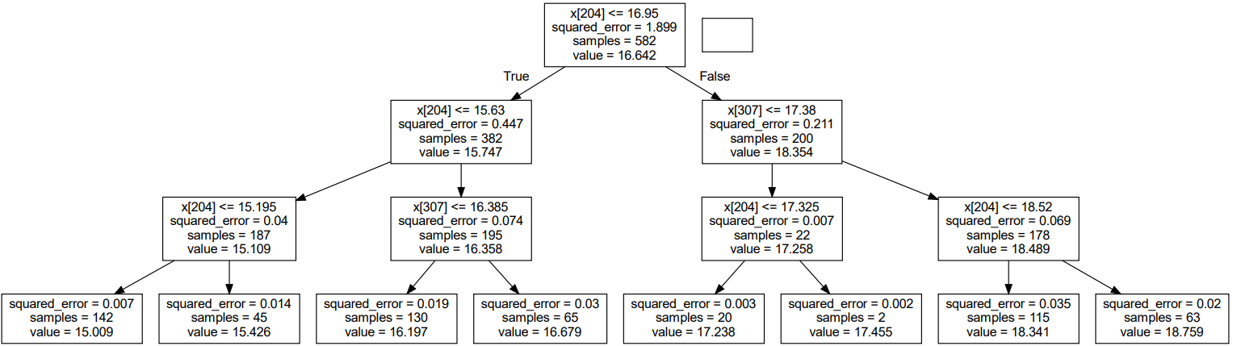
04
Experiment Results
(3/19)
01001T 土銀富邦R1
Model Explanablity
Tree Visualization
X[204]=target_lag1
X[204]=target_lag1
X[307]=target_lag2
X[204]=target_lag1
X[307]=target_lag2
X[204]=target_lag1
30

Slide 31
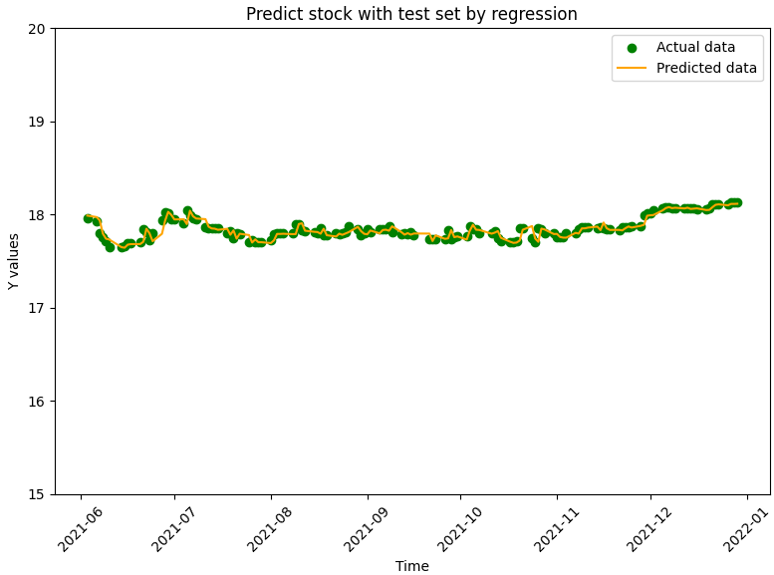
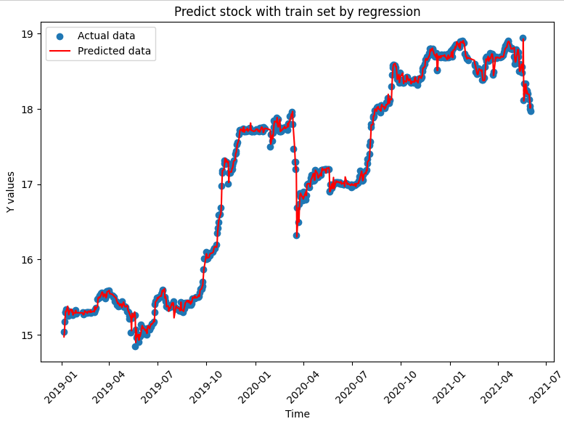
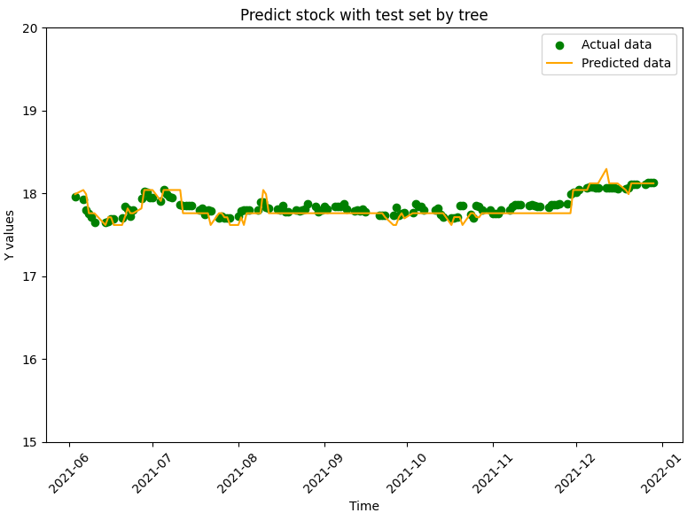
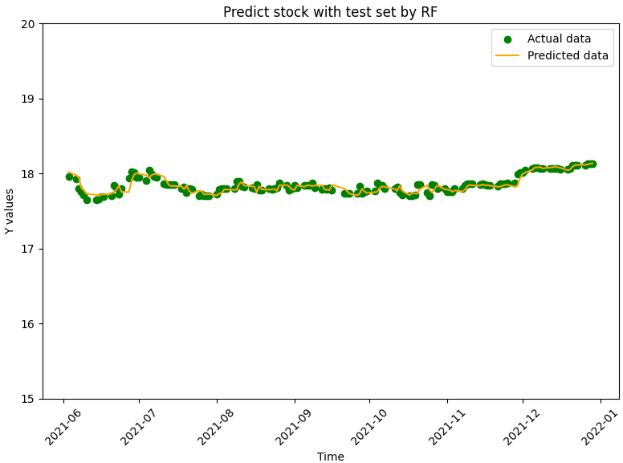
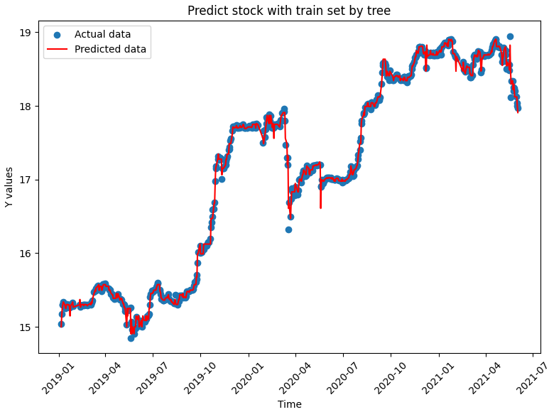
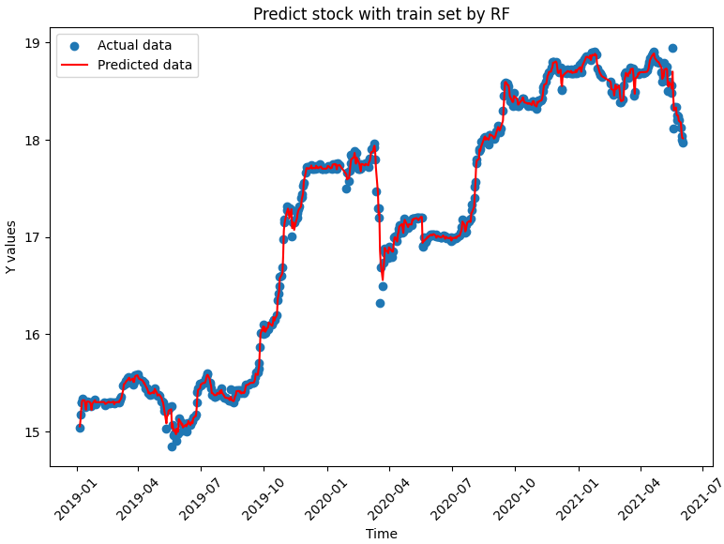
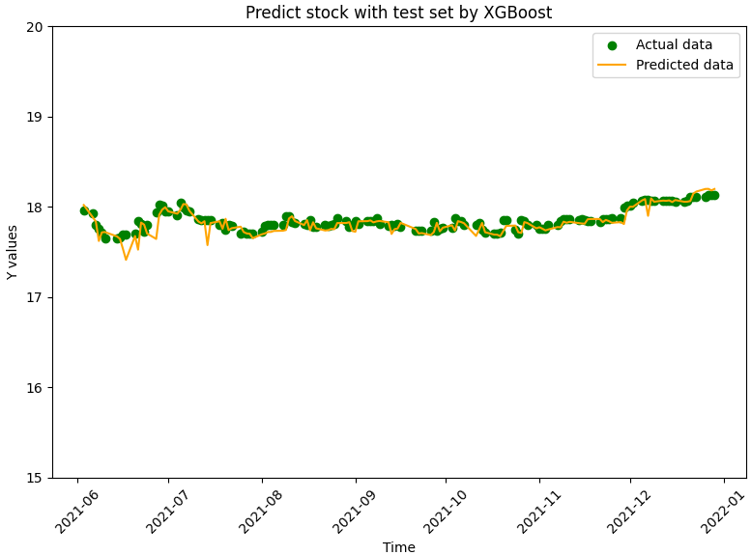
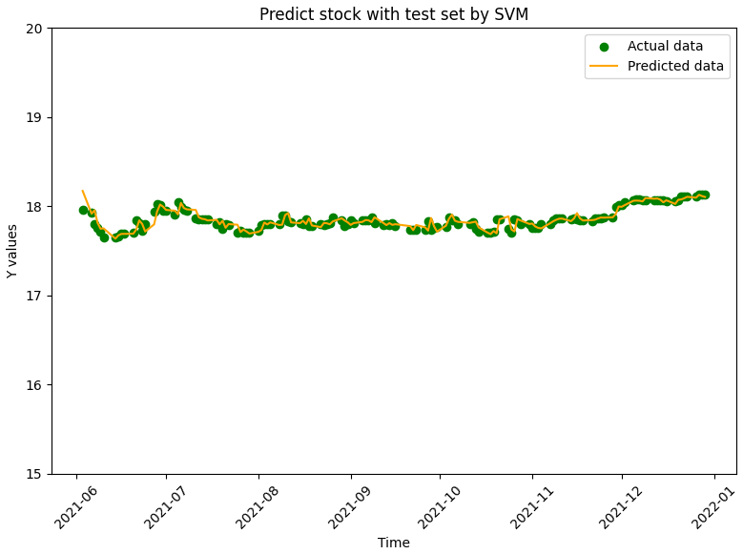
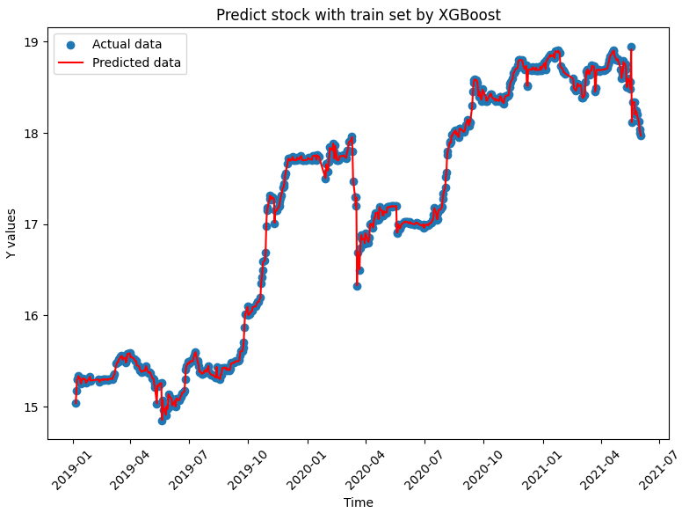
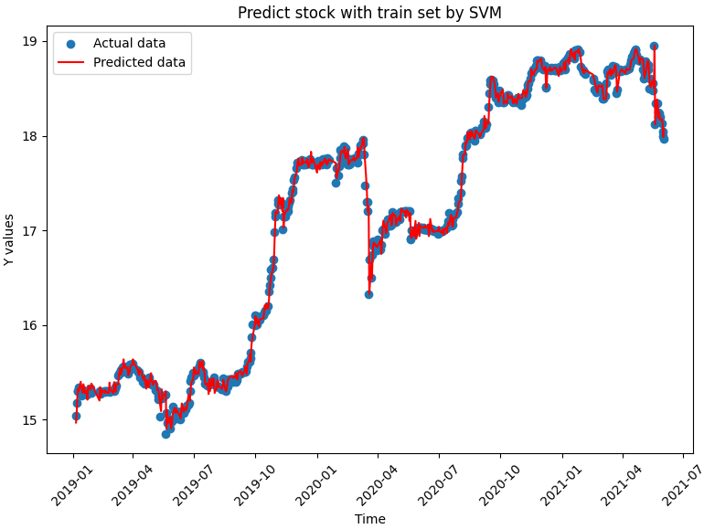
04
Experiment Results
(4/19)
Linear Regression
Testing | MAPE | MSE | RMSE
LR | 0.1799 | 0.0022 | 0.0472
TREE | 0.3581 | 0.0066 | 0.0813
RF | 0.2142 | 0.0026 | 0.0514
XGB | 0.2934 | 0.0057 | 0.0759
SVM | 0.1912 | 0.0026 | 0.0514
01002T 土銀國泰
Overall Performance Comparison
Decision Tree
Random Forest
XGBoost
Support Vector Machine
31

Slide 32
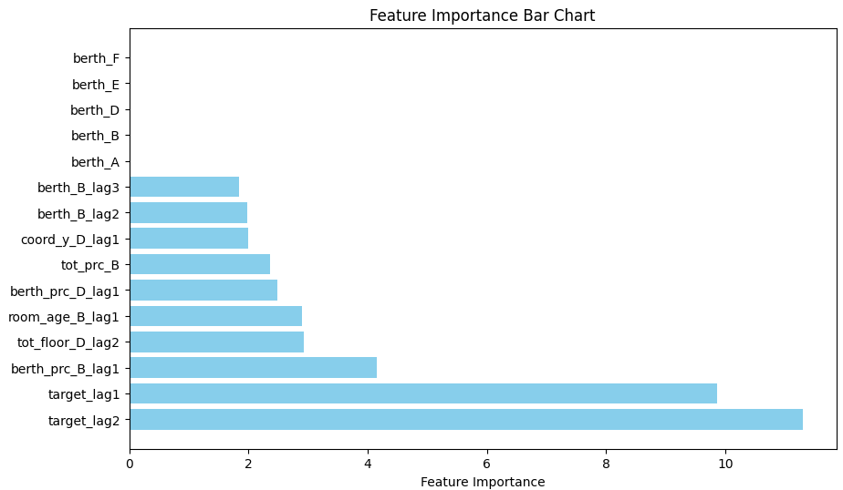
04
Experiment Results
(5/19)
01002T 土銀國泰
Model Explanablity
Feature Importance
INDEX | City | Count
A | Taipei | 0
B | Taichung | 5
D | Tainan | 3
E | Kaohsiung | 0
F | New Taipei | 0
H | Taoyuan | 0
berth 有無車位
Coor_y 經緯度
Tot_prc 總價
Room_age 屋齡
Tot_floor 總樓層數
Berth_prc 車位價格
32

Slide 33
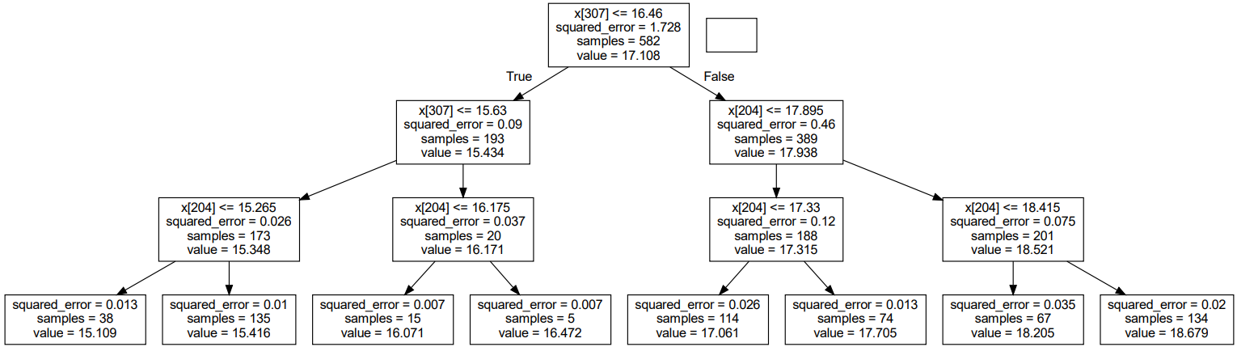
04
Experiment Results
(6/19)
01002T 土銀國泰
Model Explanablity
Tree Visualization
X[307]=target_lag2
X[307]=target_lag2
X[204]=target_lag1
X[204]=target_lag1
X[204]=target_lag1
33

Slide 34
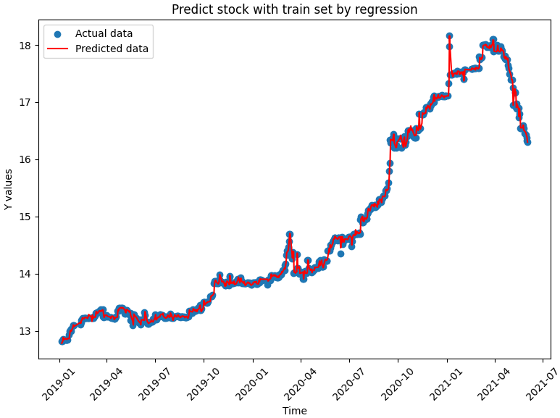
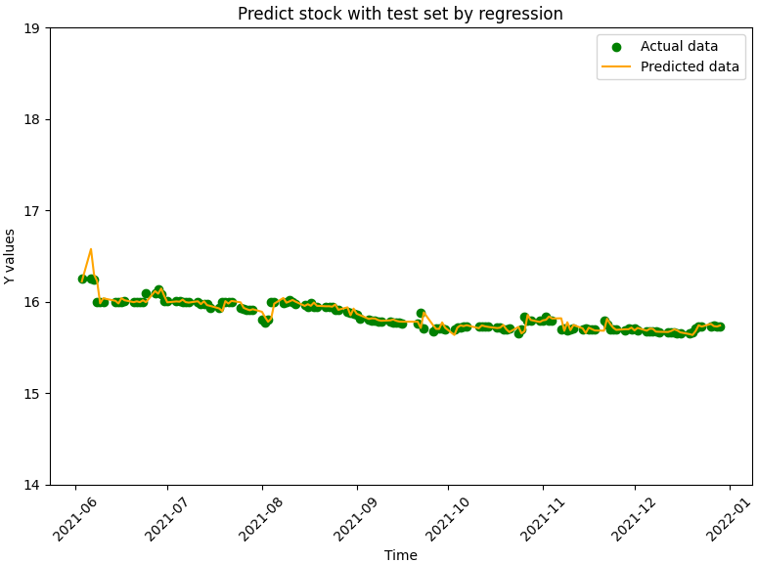
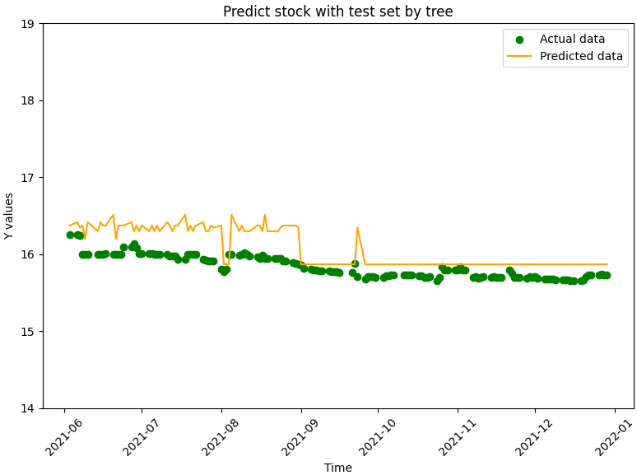
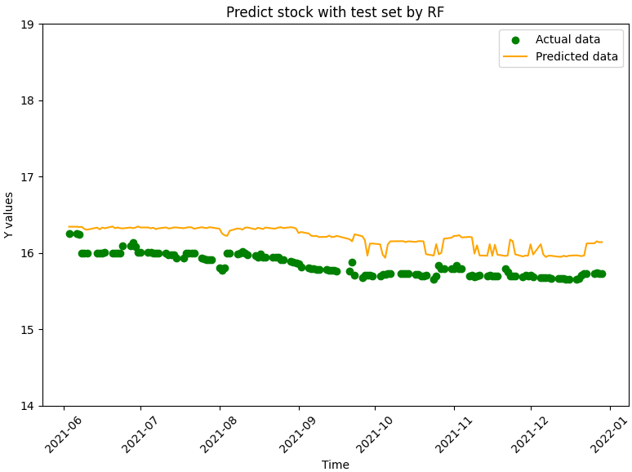
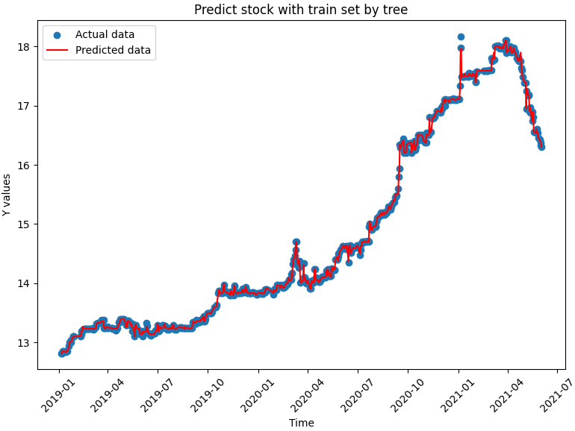





04
Experiment Results
(7/19)
Linear Regression
Testing | MAPE | MSE | RMSE
LR | 0.2025 | 0.0030 | 0.0549
TREE | 1.4743 | 0.0740 | 0.2722
RF | 2.2355 | 0.1328 | 0.3644
XGB | 1.4071 | 0.0608 | 0.2466
SVM | 0.2636 | 0.0046 | 0.0681
01004T 土銀富邦R2
Overall Performance Comparison
Decision Tree
Random Forest
XGBoost
Support Vector Machine
34

Slide 35

04
Experiment Results
(8/19)
01004T 土銀富邦R2
Model Explanablity
Feature Importance
INDEX | City | Count (rank_10) | Count(all)
A | Taipei | 3 | 12
B | Taichung | 2 | 5
D | Tainan | 1 | 3
E | Kaohsiung | 1 | 2
F | New Taipei | 0 | 0
H | Taoyuan | 0 | 0
Health 衛浴數
Tot_prc 總價
Land_area 土地移轉坪數
berth 有無車位
hall 廳數
35

Slide 36

04
Experiment Results
(9/19)
01004T 土銀富邦R2
Model Explanablity
Tree Visualization
X[307]=target_lag2
X[204]=target_lag1
X[204]=target_lag1
X[204]=target_lag1
X[204]=target_lag1
36

Slide 37
04
Experiment Results
(10/19)
Linear Regression
Testing | MAPE | MSE | RMSE
LR | 0.2853 | 0.0171 | 0.1309
TREE | 1.0194 | 0.0636 | 0.2522
RF | 1.0382 | 0.0550 | 0.2347
XGB | 1.0634 | 0.0568 | 0.2384
SVM | 0.3163 | 0.0173 | 0.1315
01007T 兆豐國泰
Overall Performance Comparison
Decision Tree
Random Forest
XGBoost
Support Vector Machine
37

Slide 38

04
Experiment Results
(11/19)
01007T 兆豐國泰
Model Explanablity
Feature Importance
INDEX | City | Count (rank_10) | Count(all)
A | Taipei | 0 | 4
B | Taichung | 3 | 5
D | Tainan | 2 | 4
E | Kaohsiung | 2 | 5
F | New Taipei | 0 | 1
H | Taoyuan | 0 | 1
Berth_area 車位面積
Coor_y 經緯度
Tot_prc 總價
Room 房數
Land 交易土地筆數
38

Slide 39

04
Experiment Results
(12/19)
01007T 兆豐國泰
Model Explanablity
Tree Visualization
X[410]=target_lag3
X[204]=target_lag1
X[410]=target_lag3
X[204]=target_lag1
X[204]=target_lag1
39

Slide 40










04
Experiment Results
(13/19)
Linear Regression
Testing | MAPE | MSE | RMSE
LR | 5.5530 | 0.2634 | 0.5132
TREE | 0.6710 | 0.0054 | 0.0735
RF | 0.4617 | 0.0024 | 0.0497
XGB | 0.4252 | 0.0025 | 0.0503
SVM | 5.6900 | 0.2779 | 0.5272
01009T 王道圓滿
Overall Performance Comparison
Decision Tree
Random Forest
XGBoost
Support Vector Machine
40

Slide 41

04
Experiment Results
(14/19)
01009T 王道圓滿
Model Explanablity
Feature Importance
INDEX | City | Count (rank_10) | Count(all)
A | Taipei | 1 | 6
B | Taichung | 1 | 3
D | Tainan | 2 | 5
E | Kaohsiung | 3 | 6
F | New Taipei | 0 | 1
H | Taoyuan | 1 | 1
berth 有無車位
Tran_up_II移轉地上樓層數
Unit_prc 每坪單價
Health 衛浴數
Build_area 建物移轉坪數
41

Slide 42

04
Experiment Results
(15/19)
01009T 王道圓滿
Model Explanablity
Tree Visualization
X[204]=target_lag1
X[204]=target_lag1
X[204]=target_lag1
X[204]=target_lag1
X[204]=target_lag1
42

Slide 43










04
Experiment Results
(16/19)
Linear Regression
Testing | MAPE | MSE | RMSE
LR | 2.4290 | 0.1872 | 0.4327
TREE | 0.4522 | 0.0038 | 0.0618
RF | 0.3349 | 0.0022 | 0.0474
XGB | 0.2944 | 0.0019 | 0.0446
SVM | 2.5307 | 0.2065 | 0.4544
01010T 京城樂富
Overall Performance Comparison
Decision Tree
Random Forest
XGBoost
Support Vector Machine
43

Slide 44

04
Experiment Results
(17/19)
01010T 京城樂富
Model Explanablity
Feature Importance
INDEX | City | Count (rank_10) | Count(all)
A | Taipei | 2 | 8
B | Taichung | 3 | 5
D | Tainan | 1 | 6
E | Kaohsiung | 1 | 3
F | New Taipei | 0 | 0
H | Taoyuan | 0 | 0
Unit_prc 每坪單價
Coor_x 經緯度
hall 廳數
Build 交易建物筆數
Tran_up_II移轉地上樓層數
Room 房數
44

Slide 45

04
Experiment Results
(18/19)
01010T 京城樂富
Model Explanablity
Tree Visualization
X[204]=target_lag1
X[204]=target_lag1
X[307]=target_lag2
X[204]=target_lag1
X[204]=target_lag1
45

Slide 46
04
Experiment Results
(19/19)
Overall comparison (city/count(rank10)/count(all))
01001T 土銀富邦R1
01004T 土銀國泰
01009T 土銀富邦R2
Count
(all)
Count
(rank10)
Count
(rank10)
Count
(rank10)
Count
(all)
City
Taipei | 1 | 6
Taichung | 1 | 3
Tainan | 2 | 5
Kaohsiung | 3 | 6
New Taipei | 0 | 1
Taoyuan | 1 | 1
Testing | MAPE | MSE | RMSE
LR | 0.4511 | 0.0709 | 0.2664
TREE | 1.9913 | 0.1832 | 0.4280
RF | 1.1448 | 0.0535 | 0.2314
XGB | 1.1851 | 0.0684 | 0.2617
SVM | 0.4799 | 0.0741 | 0.2722
City
Taipei | 2
Taichung | 3
Tainan | 0
Kaohsiung | 1
New Taipei | 1
Taoyuan | 0
Testing | MAPE | MSE | RMSE
LR | 0.2025 | 0.0030 | 0.0549
TREE | 1.4743 | 0.0740 | 0.2722
RF | 2.2355 | 0.1328 | 0.3644
XGB | 1.4071 | 0.0608 | 0.2466
SVM | 0.2636 | 0.0046 | 0.0681
City
Taipei | 3 | 12
Taichung | 2 | 5
Tainan | 1 | 3
Kaohsiung | 1 | 2
New Taipei | 0 | 0
Taoyuan | 0 | 0
Testing | MAPE | MSE | RMSE
LR | 5.5530 | 0.2634 | 0.5132
TREE | 0.6710 | 0.0054 | 0.0735
RF | 0.4617 | 0.0024 | 0.0497
XGB | 0.4252 | 0.0025 | 0.0503
SVM | 5.6900 | 0.2779 | 0.5272
01002T 兆豐國泰
01007T 王道圓滿
01010T 京城樂富
Count
(all)
Count
(rank10)
Count
(rank10)
Count
(all)
City
Taipei | 0
Taichung | 5
Tainan | 3
Kaohsiung | 0
New Taipei | 0
Taoyuan | 0
City
Taipei | 0 | 4
Taichung | 3 | 5
Tainan | 2 | 4
Kaohsiung | 2 | 5
New Taipei | 0 | 1
Taoyuan | 0 | 1
Count
(rank10)
Testing | MAPE | MSE | RMSE
LR | 0.1799 | 0.0022 | 0.0472
TREE | 0.3581 | 0.0066 | 0.0813
RF | 0.2142 | 0.0026 | 0.0514
XGB | 0.2934 | 0.0057 | 0.0759
SVM | 0.1912 | 0.0026 | 0.0514
Testing | MAPE | MSE | RMSE
LR | 0.2853 | 0.0171 | 0.1309
TREE | 1.0194 | 0.0636 | 0.2522
RF | 1.0382 | 0.0550 | 0.2347
XGB | 1.0634 | 0.0568 | 0.2384
SVM | 0.3163 | 0.0173 | 0.1315
Testing | MAPE | MSE | RMSE
LR | 2.4290 | 0.1872 | 0.4327
TREE | 0.4522 | 0.0038 | 0.0618
RF | 0.3349 | 0.0022 | 0.0474
XGB | 0.2944 | 0.0019 | 0.0446
SVM | 2.5307 | 0.2065 | 0.4544
City
Taipei | 2 | 8
Taichung | 3 | 5
Tainan | 1 | 6
Kaohsiung | 1 | 3
New Taipei | 0 | 0
Taoyuan | 0 | 0
46
Notes:
Rain13k

Slide 47
Outline
01
Introduction and Motivation
02
EDA and
Feature Engineering
03
Modeling Pipeline
04
Experiment Results
05
Conclusion and Discussion

Slide 48
01
Introduction and Motivation
02
EDA and
Feature Engineering
03
Modeling Pipeline
04
Experiment Results
05
Conclusion and Discussion

Slide 49

05
Conclusion
(1/1)
Compared to the stock price variables, the housing price have relatively small impact on modeling in the short term.
The lag_variable is important, but it make our prediction curve non-smooth, leading to unstable outcome.
Try to add more lag_variable to make a model more robust and reliable.
Not all model fits all stock.
Select suitable models and ensemble them.
Different Housing-info (實價登錄) make different influence on different stock.
49

Slide 50
Thanks for Listening

Slide 51
04
Appendix
01001T 土銀富邦R1
Data shape: [728, 410], Training [582, 410], Testing [146, 410]
Linear Regression
INDEX | train | test
MAPE | 0.2601 | 0.4511
MSE | 0.0076 | 0.0709
RMSE | 0.0874 | 0.2664
adjust r2 | 0.9955 | 1.2275
51

Slide 52
04
Appendix
01001T 土銀富邦R1
Data shape: [728, 410], Training [582, 410], Testing [146, 410]
Decision Tree
INDEX | train | test
MAPE | 0.2599 | 1.9913
MSE | 0.0050 | 0.1832
RMSE | 0.0713 | 0.4280
adjust r2 | 0.9973 | -2.6880
52

Slide 53
04
Appendix
01001T 土銀富邦R1
Data shape: [728, 410], Training [582, 410], Testing [146, 410]
Random Forest
INDEX | train | test
MAPE | 0.2507 | 1.1448
MSE | 0.0035 | 0.0535
RMSE | 0.0595 | 0.2314
adjust r2 | 0.9981 | -0.0785
53

Slide 54
04
Appendix
01001T 土銀富邦R1
Data shape: [728, 410], Training [582, 410], Testing [146, 410]
XGBoost
INDEX | train | test
MAPE | 0.0456 | 1.1851
MSE | 0.0001 | 0.0684
RMSE | 0.0102 | 0.2617
adjust r2 | 0.9999 | -0.3788
54

Slide 55
04
Appendix
01001T 土銀富邦R1
Data shape: [728, 410], Training [582, 410], Testing [146, 410]
Support Vector Machine
INDEX | train | test
MAPE | 0.3357 | 0.4799
MSE | 0.0087 | 0.0741
RMSE | 0.0933 | 0.2722
adjust r2 | 0.9949 | -1.3270
55

Slide 56
04
Appendix
01002T 土銀國泰
Data shape: [728, 410], Training [582, 410], Testing [146, 410]
Linear Regression
INDEX | train | test
MAPE | 0.2618 | 0.1799
MSE | 0.0072 | 0.0022
RMSE | 0.0850 | 0.0472
adjust r2 | 0.9954 | 0.7691
56

Slide 57
04
Appendix
01002T 土銀國泰
Data shape: [728, 410], Training [582, 410], Testing [146, 410]
Decision Tree
INDEX | train | test
MAPE | 0.1229 | 0.3581
MSE | 0.0015 | 0.0066
RMSE | 0.0391 | 0.0813
adjust r2 | 0.9991 | 0.5329
57

Slide 58
04
Appendix
01002T 土銀國泰
Data shape: [728, 410], Training [582, 410], Testing [146, 410]
Random Forest
INDEX | train | test
MAPE | 0.1297 | 0.2142
MSE | 0.0018 | 0.0026
RMSE | 0.0433 | 0.0514
adjust r2 | 0.9989 | 0.8131
58

Slide 59
04
Appendix
01002T 土銀國泰
Data shape: [728, 410], Training [582, 410], Testing [146, 410]
XGBoost
INDEX | train | test
MAPE | 0.0180 | 0.2934
MSE | 0.0000 | 0.0057
RMSE | 0.0042 | 0.0759
adjust r2 | 0.9999 | 0.5935
59

Slide 60
04
Appendix
01002T 土銀國泰
Data shape: [728, 410], Training [582, 410], Testing [146, 410]
Support Vector Machine
INDEX | train | test
MAPE | 0.3168 | 0.1912
MSE | 0.0080 | 0.0026
RMSE | 0.0894 | 0.0514
adjust r2 | 0.9949 | 0.7260
60

Slide 61
04
Appendix
(2/4)
01004T 土銀富邦R2
Data shape: [728, 410], Training [582, 410], Testing [146, 410]
Linear Regression
INDEX | train | test
MAPE | 0.2828 | 0.2025
MSE | 0.0063 | 0.0030
RMSE | 0.0796 | 0.0549
adjust r2 | 0.9974 | 0.7917
61

Slide 62
04
Appendix
01004T 土銀富邦R2
Data shape: [728, 410], Training [582, 410], Testing [146, 410]
Decision Tree
INDEX | train | test
MAPE | 0.0732 | 1.4743
MSE | 0.0004 | 0.0740
RMSE | 0.0218 | 0.2722
adjust r2 | 0.9998 | -2.5640
62

Slide 63
04
Appendix
01004T 土銀富邦R2
Data shape: [728, 410], Training [582, 410], Testing [146, 410]
Random Forest
INDEX | train | test
MAPE | 0.2697 | 2.2355
MSE | 0.0035 | 0.1328
RMSE | 0.0592 | 0.3644
adjust r2 | 0.9986 | -5.3878
63

Slide 64
04
Appendix
01004T 土銀富邦R2
Data shape: [728, 410], Training [582, 410], Testing [146, 410]
XGBoost
INDEX | train | test
MAPE | 0.0441 | 1.4071
MSE | 0.0000 | 0.0608
RMSE | 0.0088 | 0.2466
adjust r2 | 0.9999 | -1.9255
64

Slide 65
04
Appendix
01004T 土銀富邦R2
Data shape: [728, 410], Training [582, 410], Testing [146, 410]
Support Vector Machine
INDEX | train | test
MAPE | 0.3732 | 0.2636
MSE | 0.0073 | 0.0046
RMSE | 0.0856 | 0.0681
adjust r2 | 0.9970 | 0.6788
65

Slide 66


04
Appendix
01007T 兆豐國泰
Data shape: [728, 410], Training [582, 410], Testing [146, 410]
Linear Regression
INDEX | train | test
MAPE | 0.2149 | 0.2853
MSE | 0.0046 | 0.0171
RMSE | 0.0680 | 0.1309
adjust r2 | 0.9981 | 0.4925
66

Slide 67


04
Appendix
01007T 兆豐國泰
Data shape: [728, 410], Training [582, 410], Testing [146, 410]
Decision Tree
INDEX | train | test
MAPE | 0.1292 | 1.0194
MSE | 0.0017 | 0.0636
RMSE | 0.0417 | 0.2522
adjust r2 | 0.9993 | -0.2209
67

Slide 68


04
Appendix
01007T 兆豐國泰
Data shape: [728, 410], Training [582, 410], Testing [146, 410]
Random Forest
INDEX | train | test
MAPE | 0.2247 | 1.0382
MSE | 0.0036 | 0.0550
RMSE | 0.0607 | 0.2347
adjust r2 | 0.9986 | -0.0567
68

Slide 69


04
Appendix
01007T 兆豐國泰
Data shape: [728, 410], Training [582, 410], Testing [146, 410]
XGBoost
INDEX | train | test
MAPE | 0.0018 | 1.0634
MSE | 0.0000 | 0.0568
RMSE | 0.0004 | 0.2384
adjust r2 | 0.9999 | -0.0902
69

Slide 70


04
Appendix
01007T 兆豐國泰
Data shape: [728, 410], Training [582, 410], Testing [146, 410]
Support Vector Machine
INDEX | train | test
MAPE | 0.2817 | 0.3163
MSE | 0.0055 | 0.0173
RMSE | 0.0746 | 0.1315
adjust r2 | 0.9977 | 0.4877
70

Slide 71
04
Appendix
01009T 王道圓滿
Data shape: [728, 410], Training [582, 410], Testing [146, 410]
Linear Regression
INDEX | train | test
MAPE | 1.6095 | 5.5530
MSE | 0.0364 | 0.2634
RMSE | 0.1908 | 0.5132
adjust r2 | 0.5652 | -248.89
71

Slide 72
04
Appendix
01009T 王道圓滿
Data shape: [728, 410], Training [582, 410], Testing [146, 410]
Decision Tree
INDEX | train | test
MAPE | 0.1895 | 0.6710
MSE | 0.0014 | 0.0054
RMSE | 0.0377 | 0.0735
adjust r2 | 0.9842 | -2.5778
72

Slide 73
04
Appendix
01009T 王道圓滿
Data shape: [728, 410], Training [582, 410], Testing [146, 410]
Random Forest
INDEX | train | test
MAPE | 0.2144 | 0.4617
MSE | 0.0015 | 0.0024
RMSE | 0.0396 | 0.0497
adjust r2 | 0.9826 | -0.6329
73

Slide 74
04
Appendix
01009T 王道圓滿
Data shape: [728, 410], Training [582, 410], Testing [146, 410]
XGBoost
INDEX | train | test
MAPE | 0.1189 | 0.4252
MSE | 0.0002 | 0.0025
RMSE | 0.0147 | 0.0503
adjust r2 | 0.9975 | -0.6760
74

Slide 75
04
Appendix
01009T 王道圓滿
Data shape: [728, 410], Training [582, 410], Testing [146, 410]
Support Vector Machine
INDEX | train | test
MAPE | 1.6172 | 5.6900
MSE | 0.0372 | 0.2779
RMSE | 0.1929 | 0.5272
adjust r2 | 0.5554 | -262.64
75

Slide 76
04
Appendix
01010T 京城樂富
Data shape: [728, 410], Training [582, 410], Testing [146, 410]
Linear Regression
INDEX | train | test
MAPE | 0.9693 | 2.4290
MSE | 0.0171 | 0.1872
RMSE | 0.1310 | 0.4327
adjust r2 | 0.8216 | -5.3481
76

Slide 77
04
Appendix
01010T 京城樂富
Data shape: [728, 410], Training [582, 410], Testing [146, 410]
Decision Tree
INDEX | train | test
MAPE | 0.1420 | 0.4522
MSE | 0.0004 | 0.0038
RMSE | 0.0221 | 0.0618
adjust r2 | 0.9953 | 0.9096
77

Slide 78
04
Appendix
01010T 京城樂富
Data shape: [728, 410], Training [582, 410], Testing [146, 410]
Random Forest
INDEX | train | test
MAPE | 0.0787 | 0.3349
MSE | 0.0001 | 0.0022
RMSE | 0.0126 | 0.0474
adjust r2 | 0.9984 | 0.9469
78

Slide 79
04
Appendix
01010T 京城樂富
Data shape: [728, 410], Training [582, 410], Testing [146, 410]
XGBoost
INDEX | train | test
MAPE | 0.0146 | 0.2994
MSE | 0.0000 | 0.0019
RMSE | 0.0020 | 0.0446
adjust r2 | 0.9999 | 0.9528
79

Slide 80
04
Appendix
01010T 京城樂富
Data shape: [728, 410], Training [582, 410], Testing [146, 410]
Support Vector Machine
INDEX | train | test
MAPE | 0.9953 | 2.5307
MSE | 0.0177 | 0.2065
RMSE | 0.1330 | 0.4544
adjust r2 | 0.8161 | -6.0009
80

Slide 81


04
Appendix
81

Slide 82
04
Appendix
82

